Slide 1


CS434
Detecting Insults in Social Commentary
Aymen Hammami - Aziz Maazouz

Slide 2

Overview
Problem
Solution
Objectives
Data Understanding
Data Preparation & Pre-processing
Feature Selection

Slide 3


Problem
Online spaces, especially public spaces such as social media, games, forums, chatting apps allows us to engage in discussions.
However, not all of those interactions are constructive or respectful. Some online users take advantage of their anonymity and the lack of consequences to post insulting comments

Slide 4

Solution
There is no doubt that the significance of monitoring and moderating online platforms has become increasingly important.
A possible solution is implementing a system that can detect whether or not a given message is insulting and takes appropriate action against it.

Slide 5



Objectives
Help moderate forums and discussions
Take unbiased and precise decisions
Take restrictive actions on users

Slide 6




Data
Understanding
To properly understand the training data we are dealing with, we need to:
Import the dataset
Explore the dataset

Slide 7

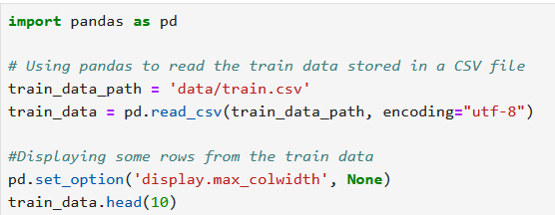
Importing Dataset
Code that imports the CSV dataset

Slide 8

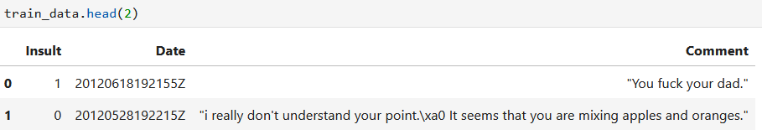
Exploring Dataset
The dataset consists of 3947 samples.
The dataset is structured by 3 columns: Insult, Date, and Comment

Slide 9
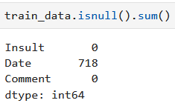
Exploring Dataset
Insult: Label of 1 is an insult. 0 is not an insult.
Date: Format: YYYYMMDDHHMMSSZ | Some dates are null.
Comment: The contents of the comment between quotes.

Slide 10






Data Preparation
&
Pre-processing
Data Cleaning
Initial Data Visualization
Data Reduction
Data Transformation
Final Data Visualization

Slide 11
Data Cleaning
Create copies of columns to cache their original state
Convert all upper-cases to lower-cases
Remove new line symbols
Remove all HTML tags, links, embeds
Remove all non ASCII characters
Remove all leading and trailing white spaces
Change the format of dates to something more readable
Change the dates that are null to “Unknown”

Slide 12
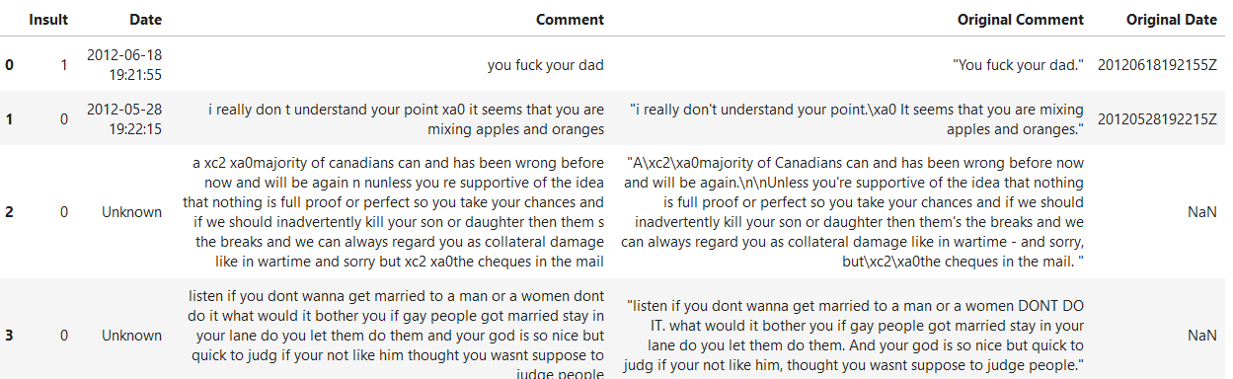
Data Cleaning
Example of data after cleaning

Slide 13
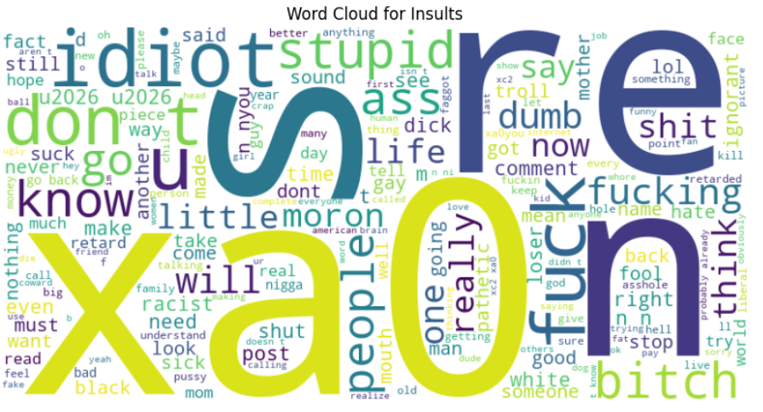
Initial Data Visualization
Word Cloud for Insults

Slide 14
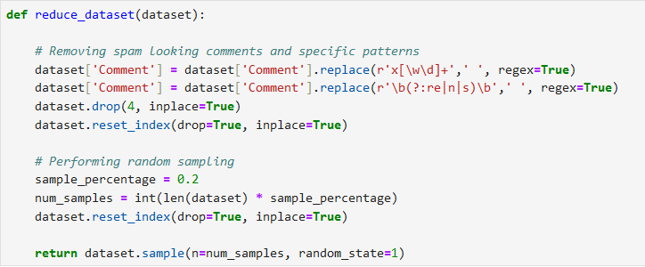
Data Reduction
Code that performs data reduction

Slide 15
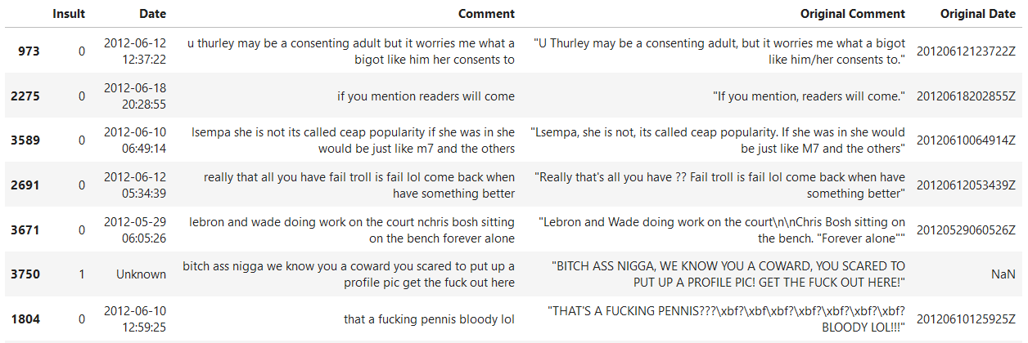
Data Reduction
Dataset after reduction (composed of 789 samples)

Slide 16
Data Transformation
Tokenize all the words in a given comment
Remove stop words from the tokens (but, if..)
Stem all the words (apples -> appl)
Replace slang words with formal equivalent (u -> you)

Slide 17
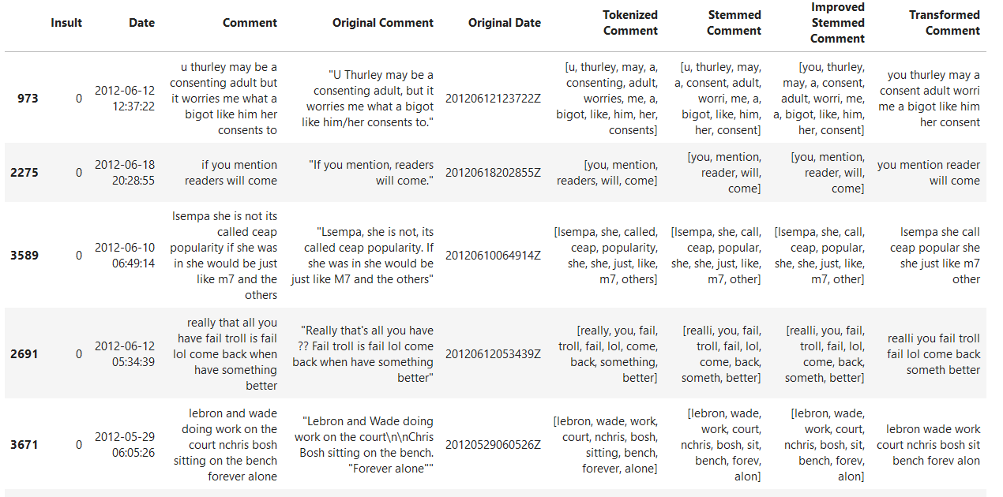
Data Transformation

Slide 18
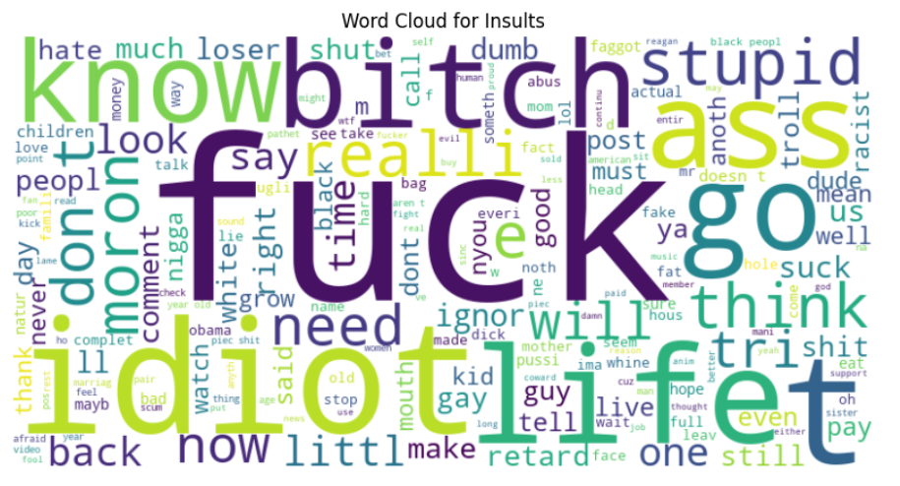
Final Data Visualization
Word Cloud for Insults

Slide 19
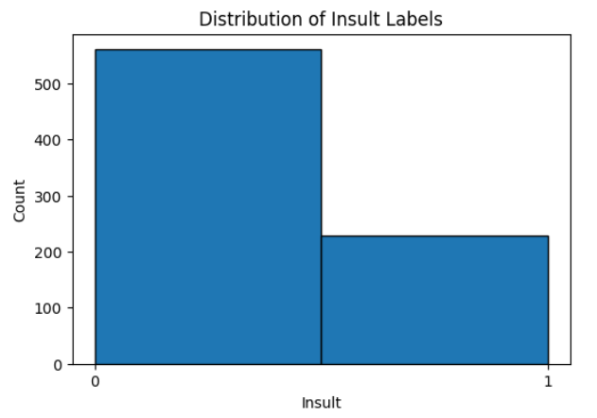
Final Data Visualization
Distribution of Insult Labels

Slide 20
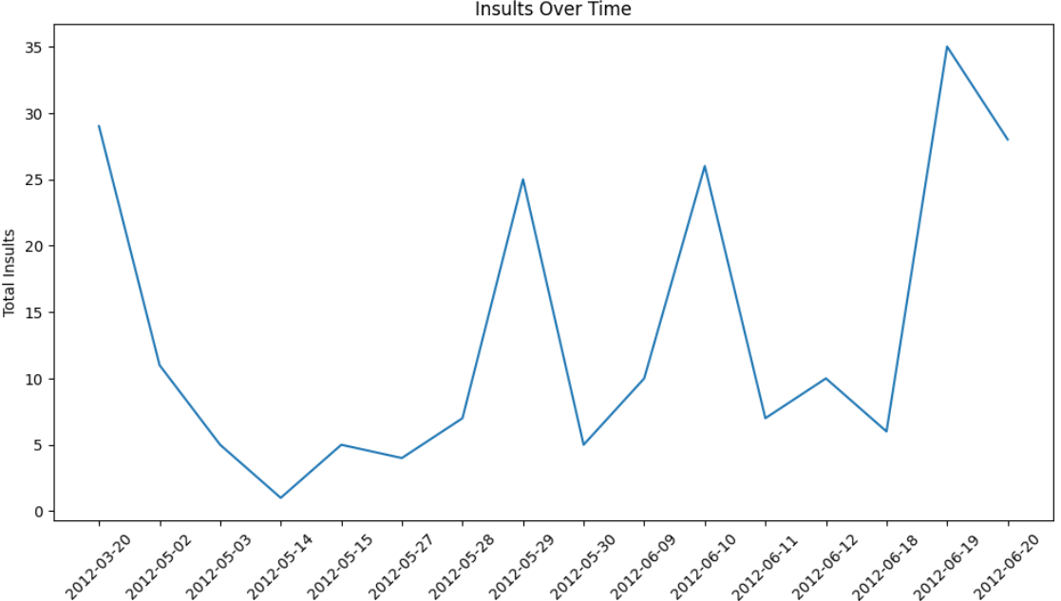
Final Data Visualization
Insults Over Time

Slide 21
Feature Selection
We decided to only use the following columns:
Insult: Labels, 0 or 1, that represent a non-insulting comment and an insulting one, respectively.
Improved Stemmed Comment: List of tokenized and transformed words that matter in a comment
Transformed Comment: The comment rewritten using the tokenized and transformed words that matter.

Slide 22
Feature Selection
We decided to use the following to feed data to our classifier:
Count Vectorizer: Count frequency of words and convert comment data into numerical vectors.
TF_IDF Transformer: Measure importance of words relative to their frequency and uniqueness.
Bad Words Transformer: Measure frequency of bad words in a given comment

Slide 23

THANK YOU
Do you have any questions?

